Slide 1
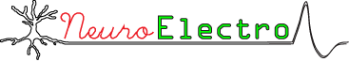
Open(ing) Electrophysiology data
Shreejoy Tripathy, Post-Doc
University of British Columbia, Canada
Email: stripathy@chibi.ubc.ca
Twitter: @neuronJoy

Slide 2
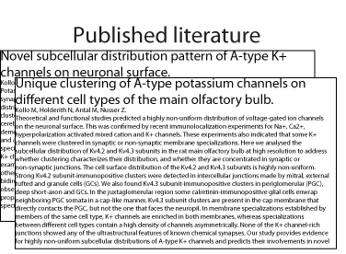
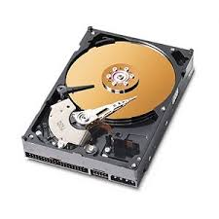

Where the ephys data at?

Slide 3
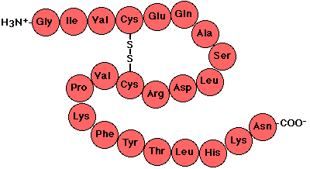
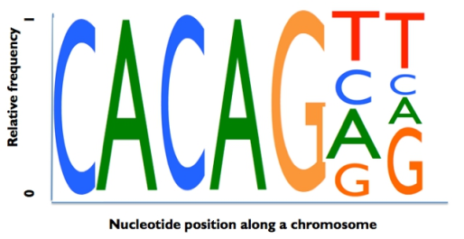
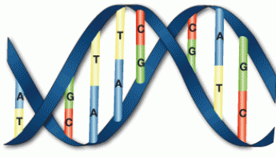
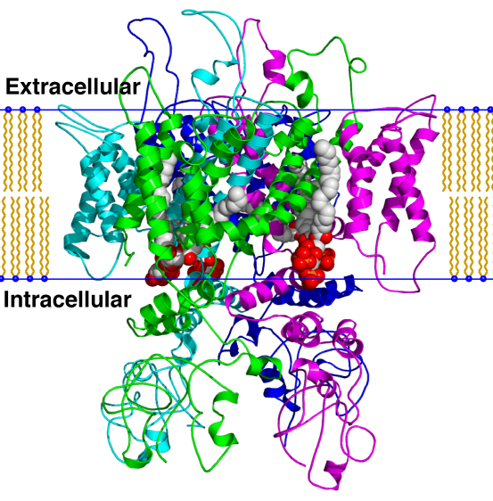
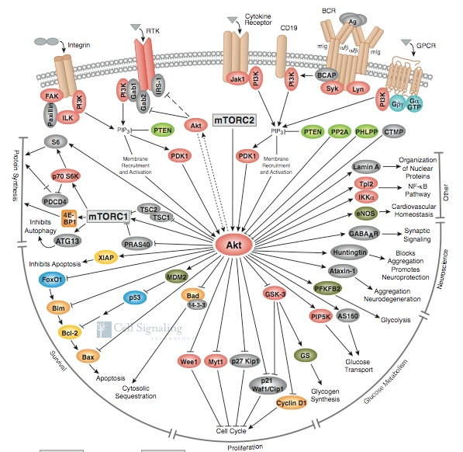

By contrast, in genomics and molecular biology…
Nucleic acid sequences
Protein sequences
Genomics databases
Molecular signalling pathways
Protein structures
http://www.ncbi.nlm.nih.gov/refseq/

Slide 4
Electrophysiology databases
NeuroElectro
CRCNS.org
Allen Institute
Neurodata Without Borders file format
Others?

Slide 5
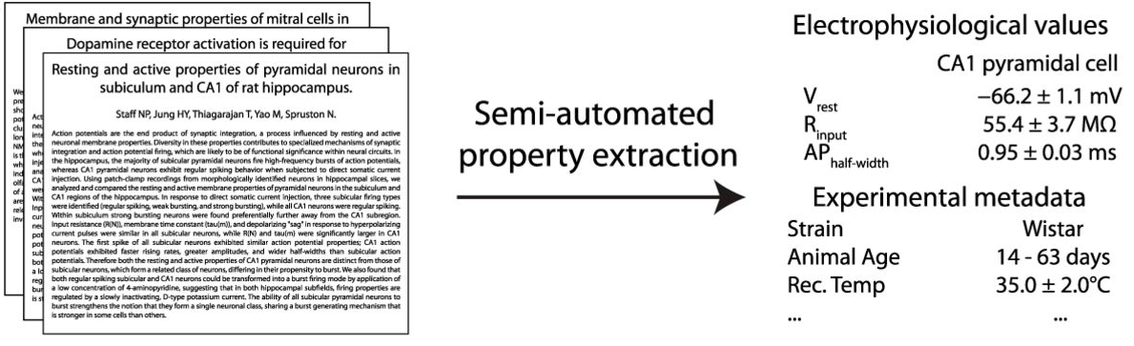
Tripathy et al, Front Neuroinf 2014
Tripathy et al, J Neurophys 2015

Slide 6
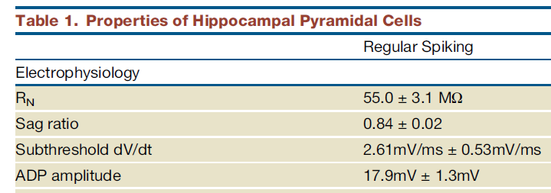
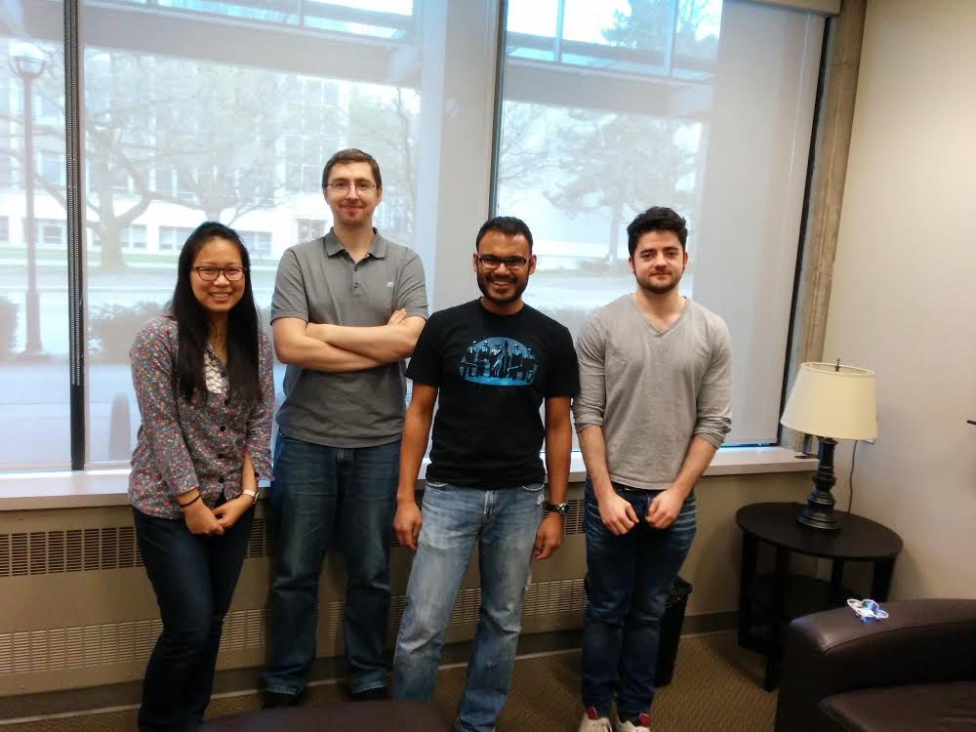
Semi-automated literature-mining overview
Download thousands of full-text articles from neuroscience-specific journals
Simple algorithms that use simple text searching to identify:
Biophysical properties (in normotypic conditions)
Neuron types (from NeuroLex.org)
Biophysical data values
Methodological details
Text-mined data is then checked by human curators
Tripathy et al, Front Neuroinf 2014

Slide 7
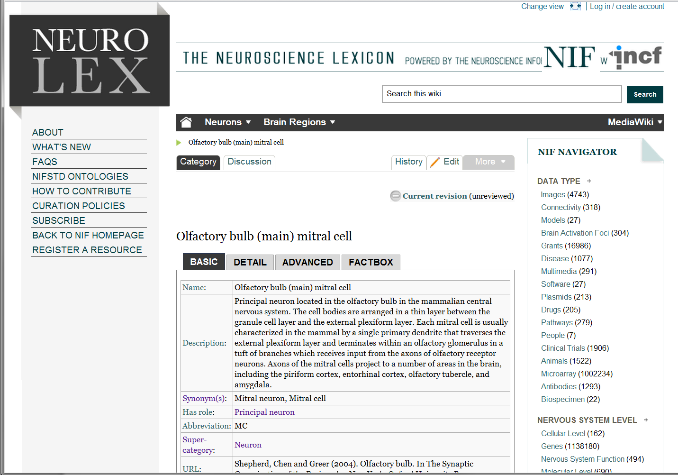
Identifying neuron types
Utilize existing expert-generated lists of mammalian neuron types (NeuroLex.org)
Developed by Gordon Shepherd and colleagues, semi-standardizes Petilla conventions
Tends to “lump” neuron types (as opposed to “split”)
Larson and Martone, 2013

Slide 8
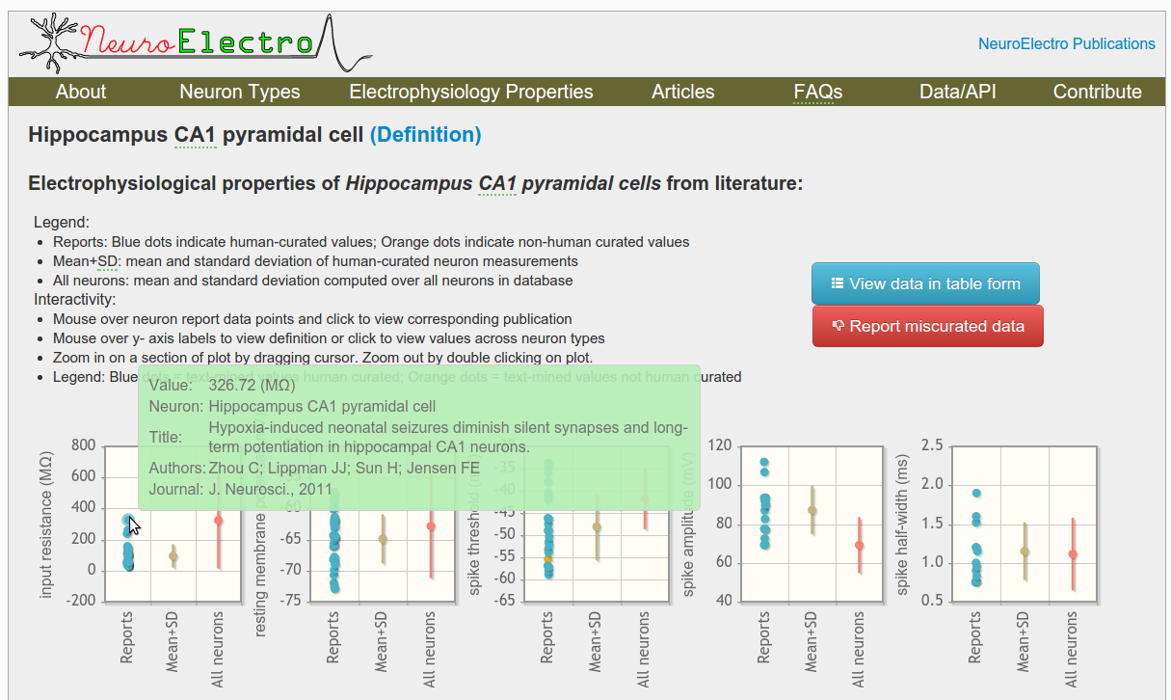
NeuroElectro.org web interface
[Demo of web resource and interface]
Code at github.com/neuroelectro
Data at neuroelectro.org/api

Slide 9
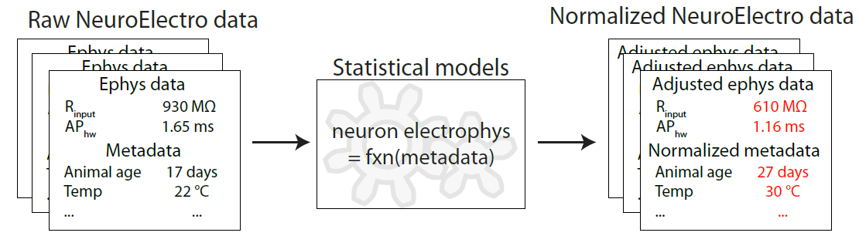
Accounting for differences in experimental conditions
Tripathy et al, J Neurophys 2015

Slide 10
NeuroElectro resource summary
NeuroElectro provides a database of neuron types and intrinsic physiological parameters curated from the literature
2.5K data points, 100 neuron types, 300 papers mined and curated
All data made available for easy download (neuroelectro.org/api)
Ongoing database developments:
Increasing literature coverage
Extending experimental conditions mined : recording solutions, electrode resistances
Improving neuron type mapping and resolution
Extending to non-normal conditions (gene knockouts, pharmacology, behavioral treatments)
Incorporating data from raw traces

Slide 11
What does it mean to “share data”?
Publishing a paper/book
Making an Excel spreadsheet of “the data” available, either as supplemental data or on FigShare
Making the raw data available (and the appropriate metadata!)

Slide 12
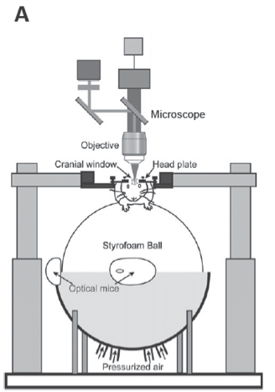
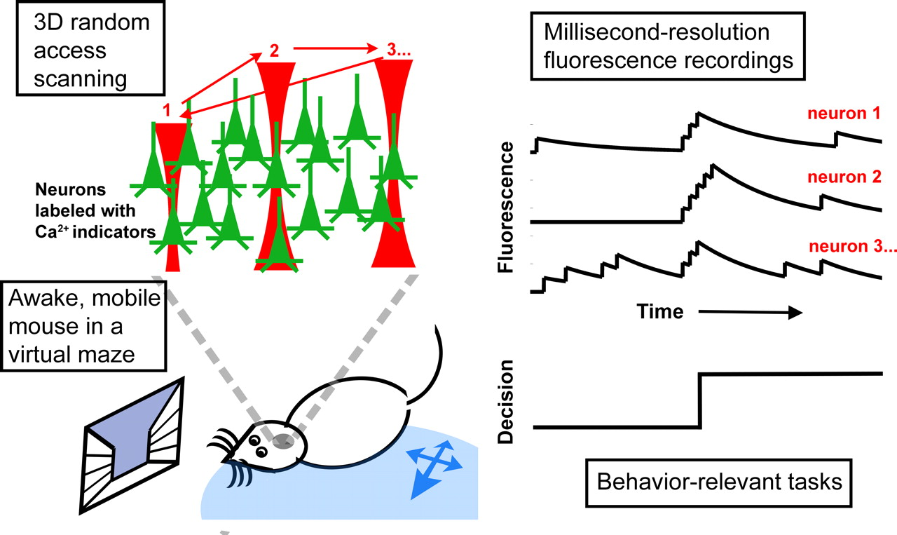
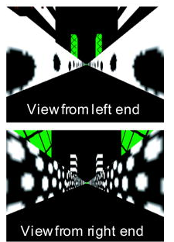
Data can be very complicated
Harvey et al, 2009; Kwan et al 2008

Slide 13
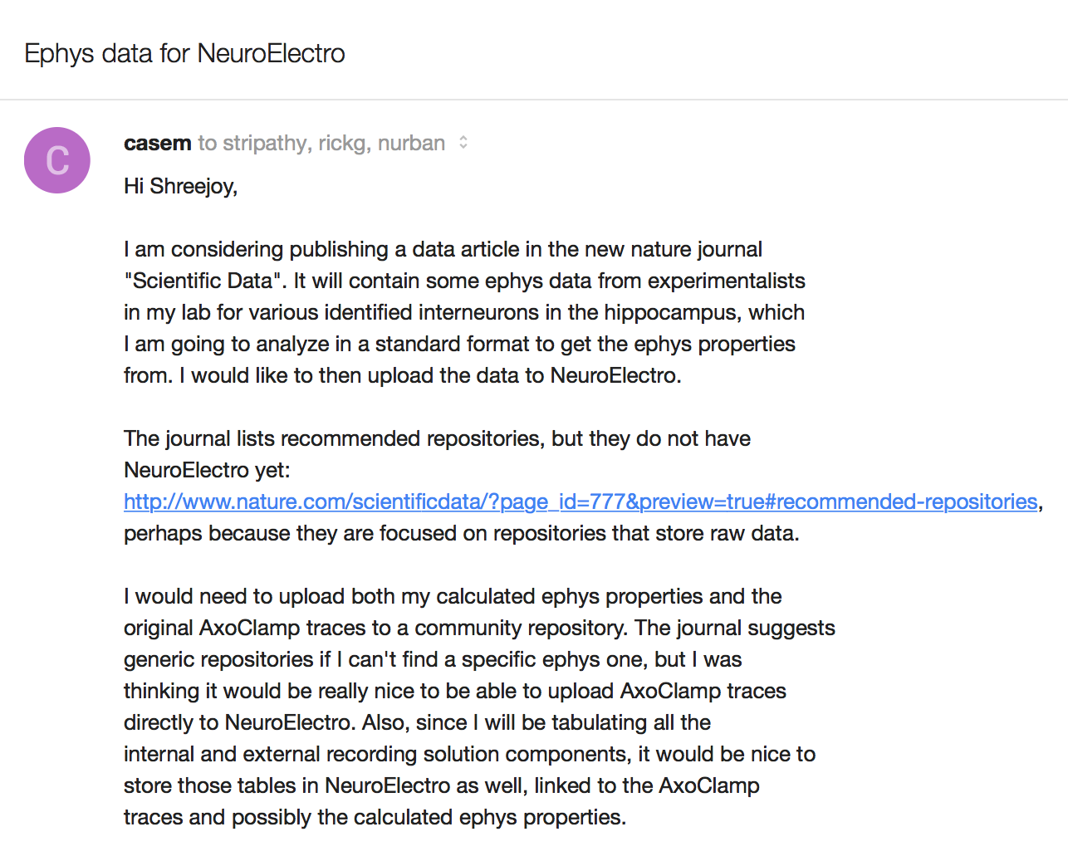

“Can I upload my raw data to your repository?”
Marianne Bezaire from UCI

Slide 14
Neurodata-without-borders project
A one year project to make a usable file format and data standards for neurophysiology data
Produced during small working group meetings of data collectors (Allen Institute, Janelia) and curators
Designed around specific datasets which are typical of the subfield
https://crcns.org/NWB/Overview

Slide 15
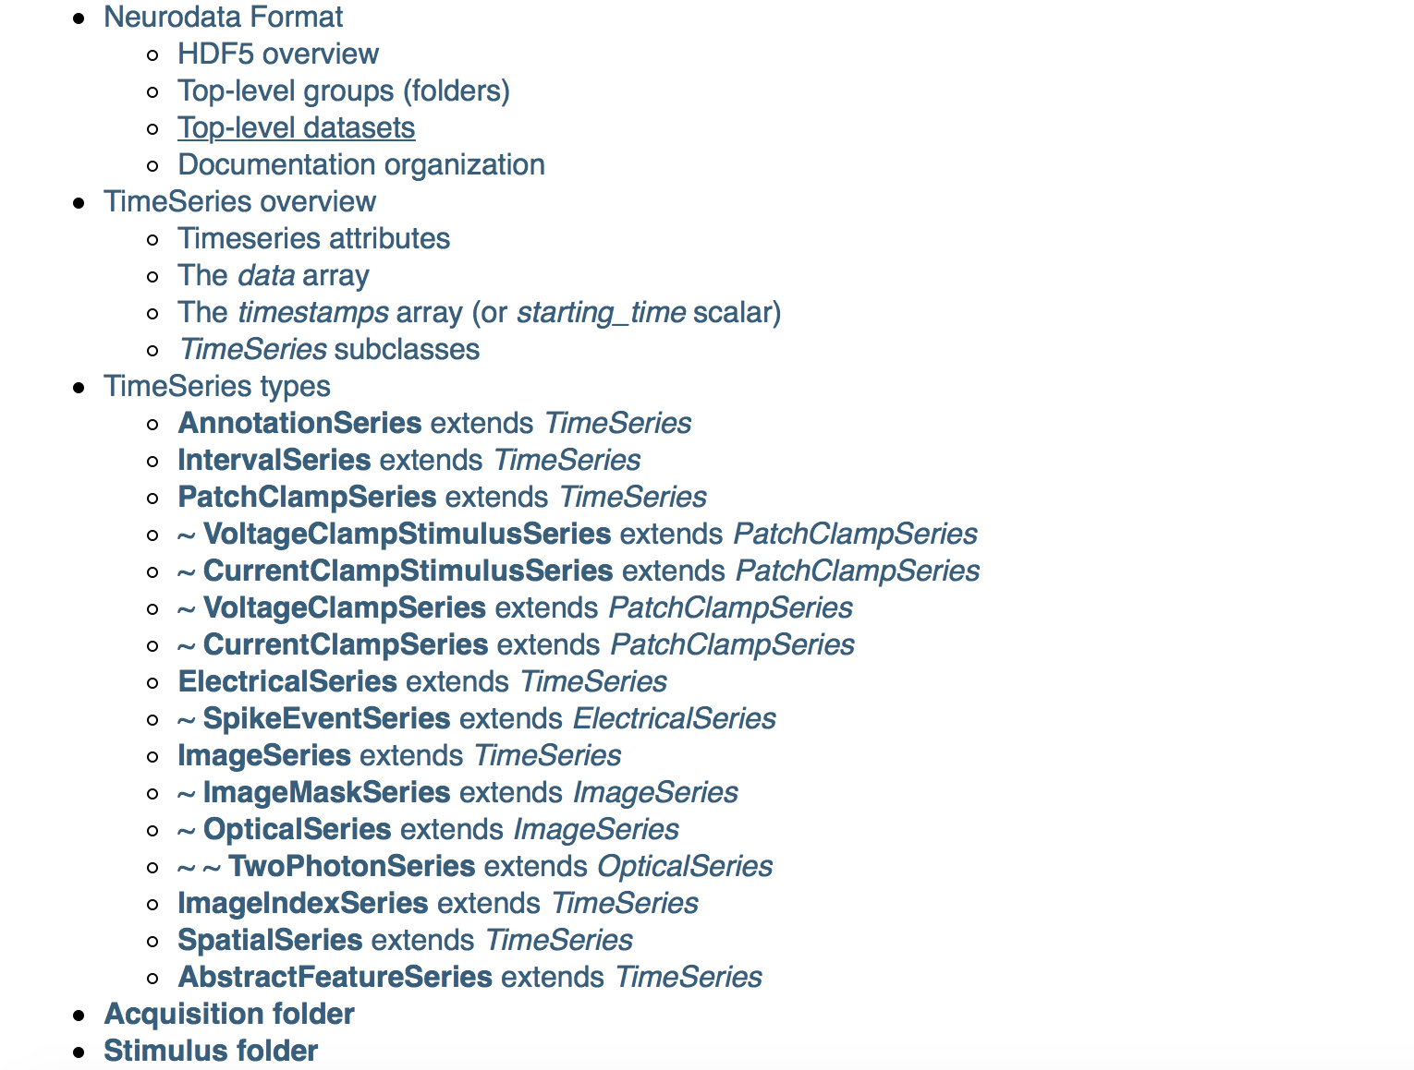
Neurodata-without-borders project
http://neurodatawithoutborders.github.io

Slide 16
Neurodata-without-borders project
Not just a file format, but also a schema
Specifies how things should be stored (HDF5) as well as where in the file
Allows parsing and using a data file without having to deeply understand how the data is stored in the file

Slide 17
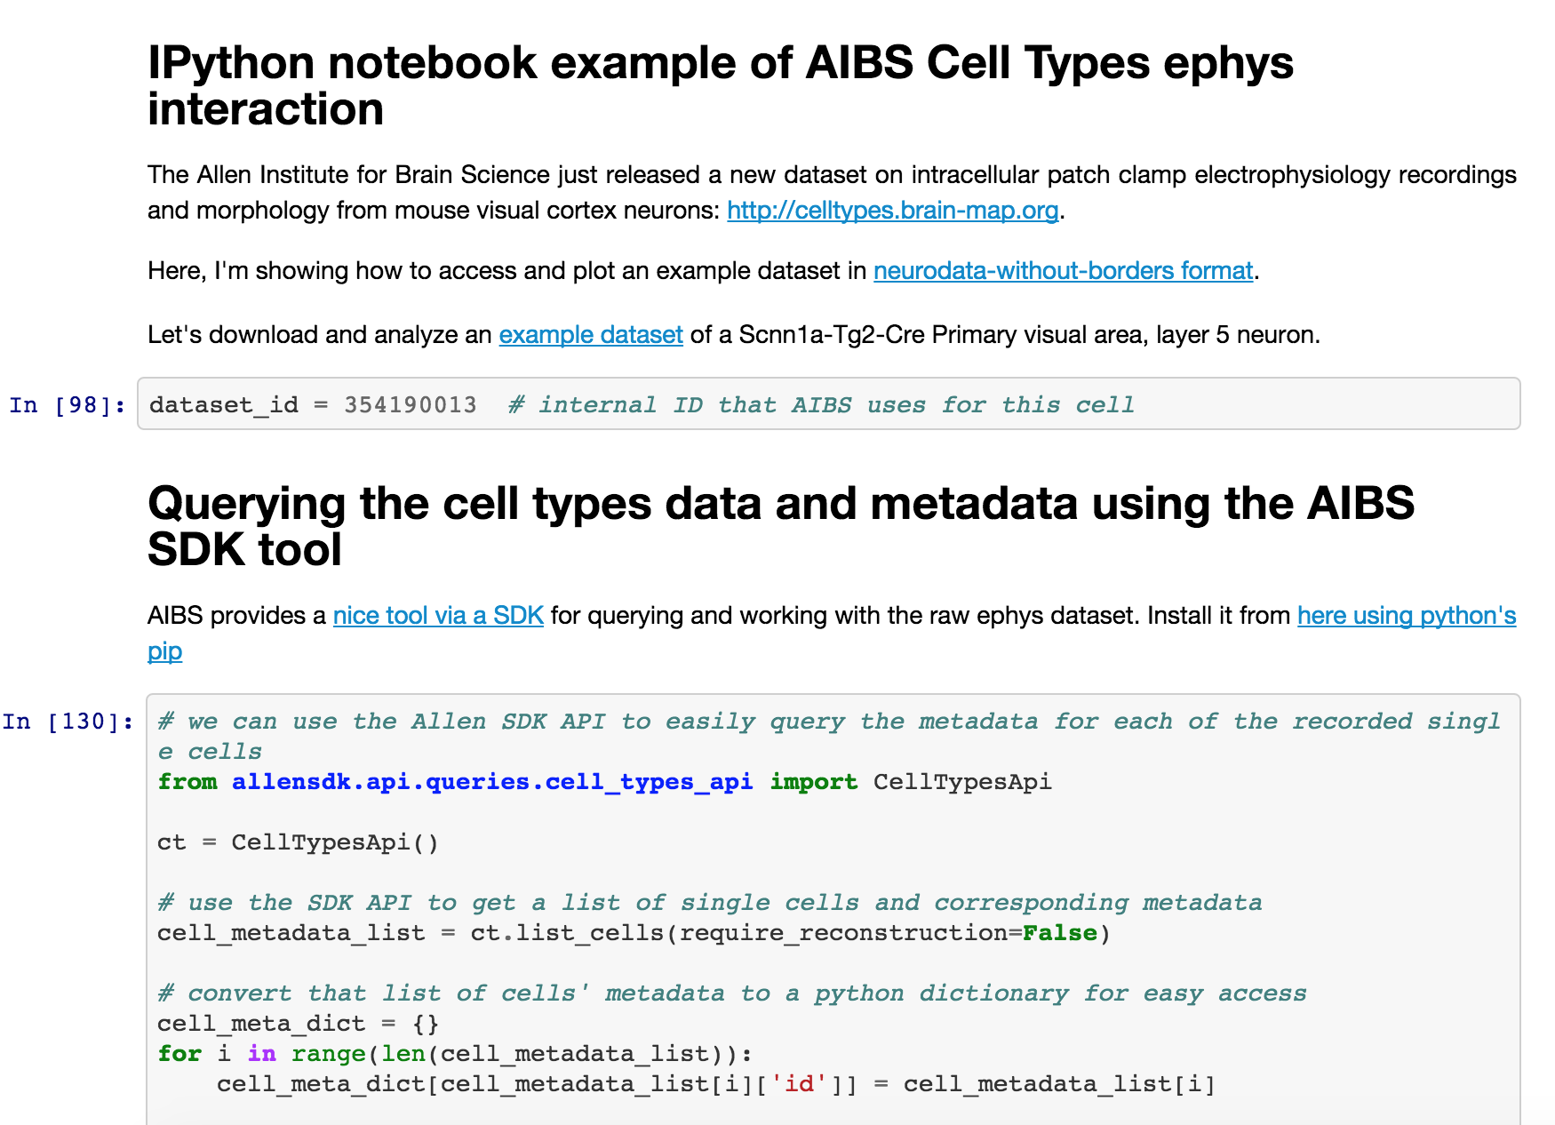
Neurodata-without-borders project
https://github.com/stripathy/AIBS_cell_types/blob/master/Allen_ephys_playground.ipynb

Slide 18
Conclusions and Questions
Opening up previously closed datasets is hard and multifaceted
Effort to continue and improve text and data mining existing publications
Improving the neuron type ontology
Helping OpenWorm curate ion channel data from the literature
Effort to push sharing of raw datasets
Like developing standards (Neurodata Without Borders)
Advocacy in the experimental community
Novel applications of large-scale open datasets
(what actually pays the bills)

Slide 19



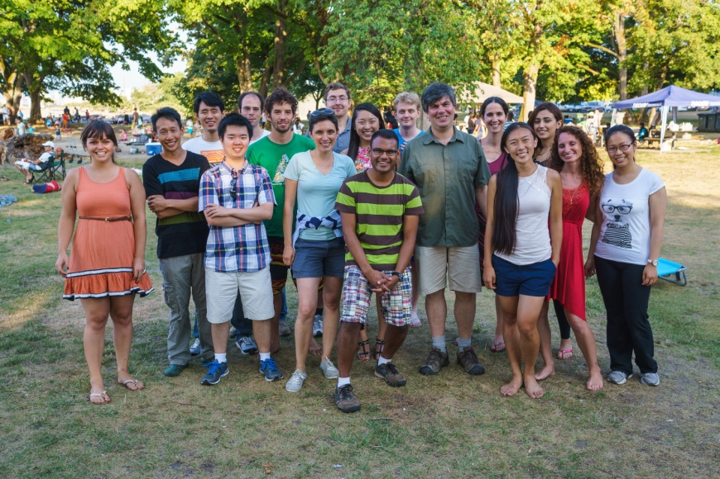




Acknowledgements
Pavlidis lab at University of British Columbia
Rick Gerkin (Arizona State)
Shreejoy Tripathy
Email: stripathy@chibi.ubc.ca
Twitter: @neuronJoy
URL: neuroelectro.org
Code: github.com/neuroelectro

